Slide 1

AgriBaato UI/UX Design

Slide 2
Agenda
Project Title
Aim of the Project
Target Audience
Unique Selling Point
Production Process
Survey Insights

Slide 3
Project Title
AgriBaato: Connecting Agriculture and Technology in Nepal
A digital solution that connects farmers, traders, and agribusinesses using real-time pricing, a transparent bidding system and an easy-to-use marketplace to improve and streamline agricultural trading.

Slide 4
Aim of the Project
The aim of this project is to design a responsive and user-friendly interface for AgriBaato, a platform that connects farmers and corporate users in Nepal.
It focuses on enhancing usability, transparency, and communication in agricultural transactions while reducing reliance on middlemen through direct buyer-seller interaction.

Slide 5
Target Audience
Demographics: Nepalese farmers, traders, cooperatives, and agribusiness professionals, aged 25–55, mainly from rural and semi-urban areas.
Inclusivity: Gender-inclusive platform supporting both men and women, reflecting increasing female participation in agriculture.
Need-Based Targeting: Farmers require real-time pricing and market access, while corporate users need tools for bidding and service networking.
Ethnicity: Made for people from all ethnic groups in Nepal, so it works well and feels relevant to everyone.

Slide 6
Unique Selling Point
Live up-to-do crop pricing data
Bidding System for bulk deals
One click Marketplace
Local Agricultural Focus
Visual and interactive UX

Slide 7
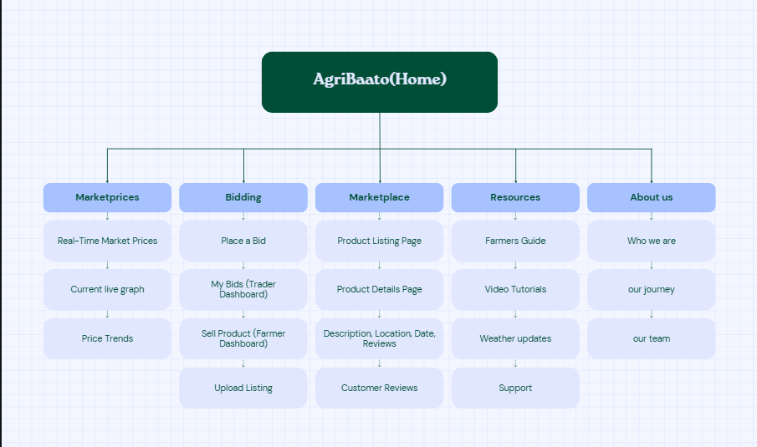
Information Architecture

Slide 8



Production Process

Slide 9
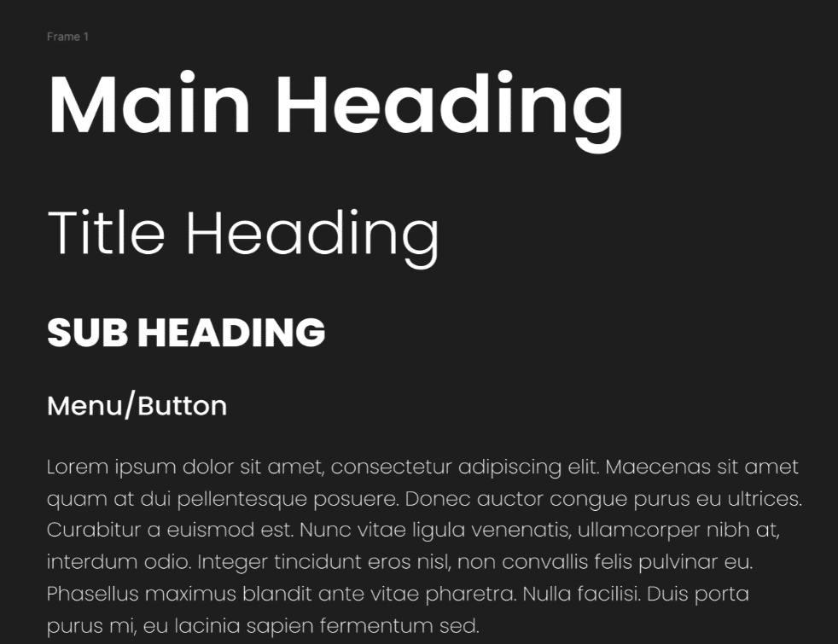
Topography
On the desktop, the heading has a 72px size in the heading, 54px size in the title heading, 36px size in the sub-heading, 24px size in the menu, 18px size in the body, and 14px in the footer.
The font used for this website is Poppins.

Slide 10
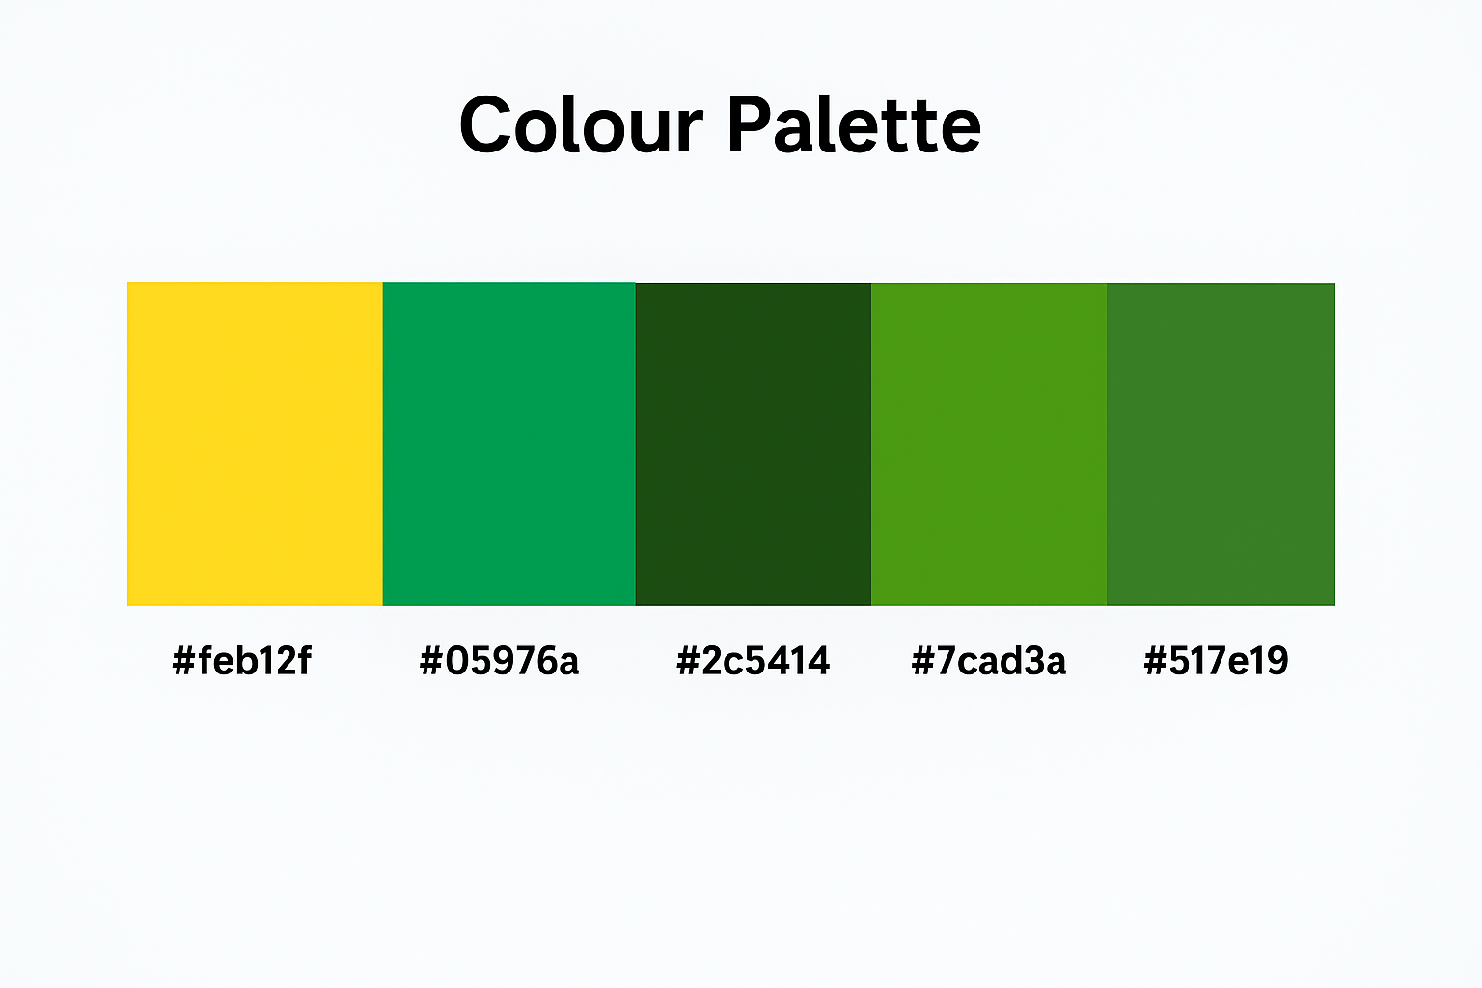
Colour Palette

Slide 11
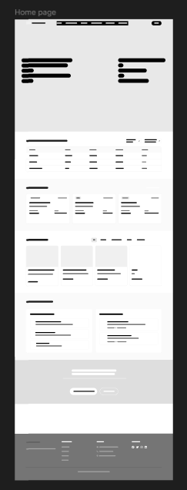
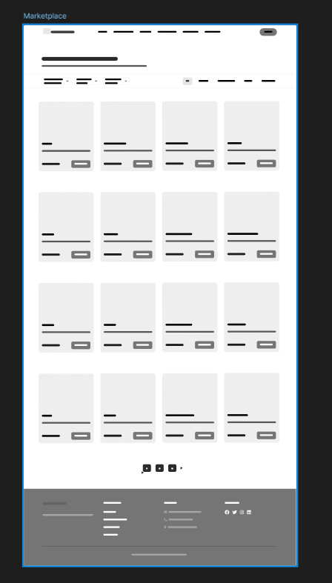
Skeleton
Wireframes helped us design the skeleton of the website, ensuring the placement of key elements was intuitive and user-friendly.

Slide 12
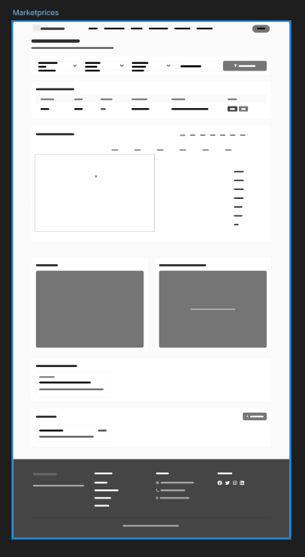
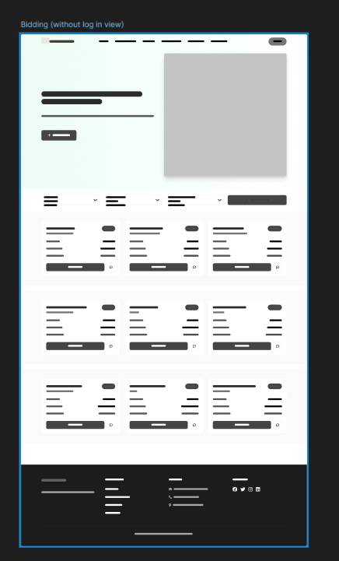
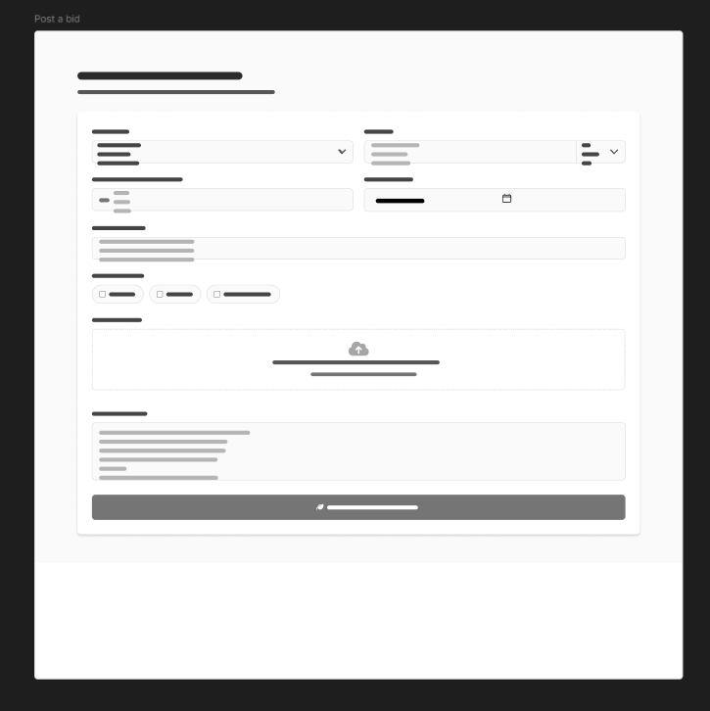
Skeleton
Wireframes helped us design the skeleton of the website, ensuring the placement of key elements was intuitive and user-friendly.

Slide 13
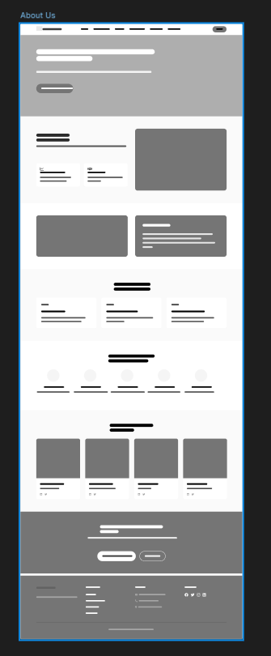
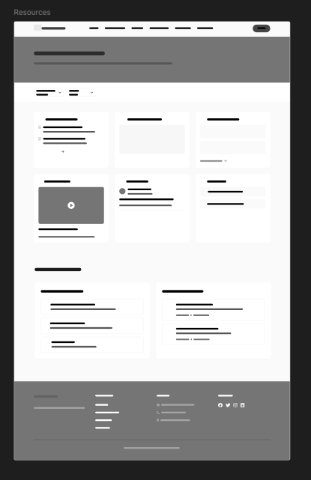
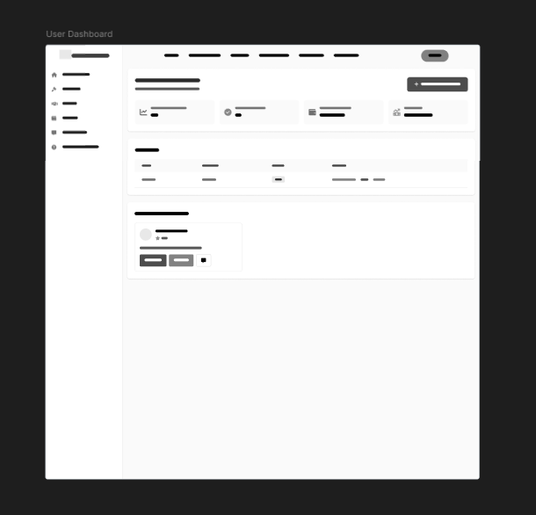
Skeleton
Wireframes helped us design the skeleton of the website, ensuring the placement of key elements was intuitive and user-friendly.

Slide 14
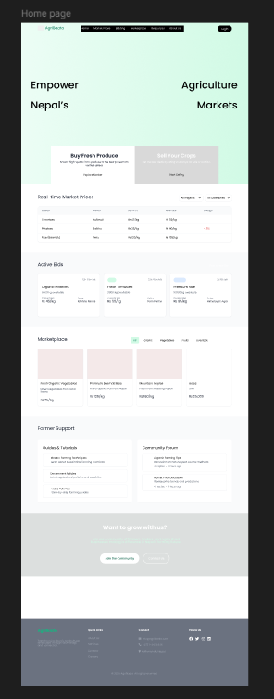
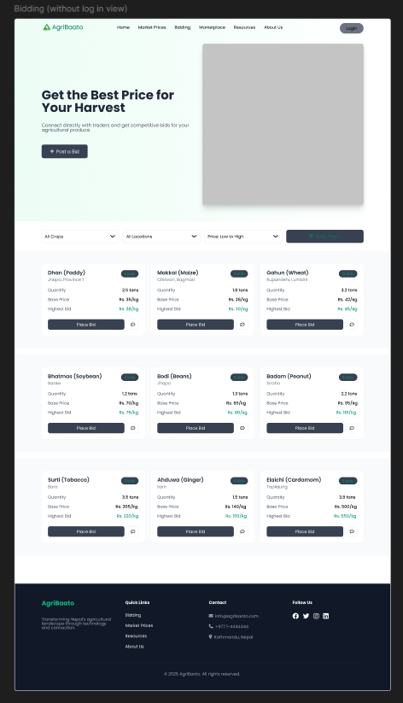
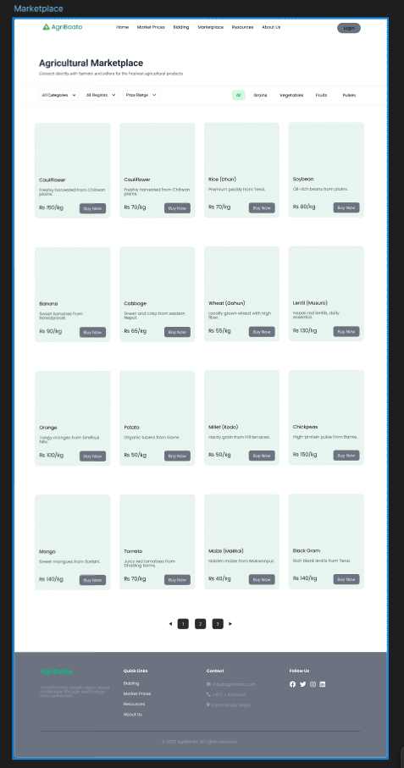
Low fidelity

Slide 15
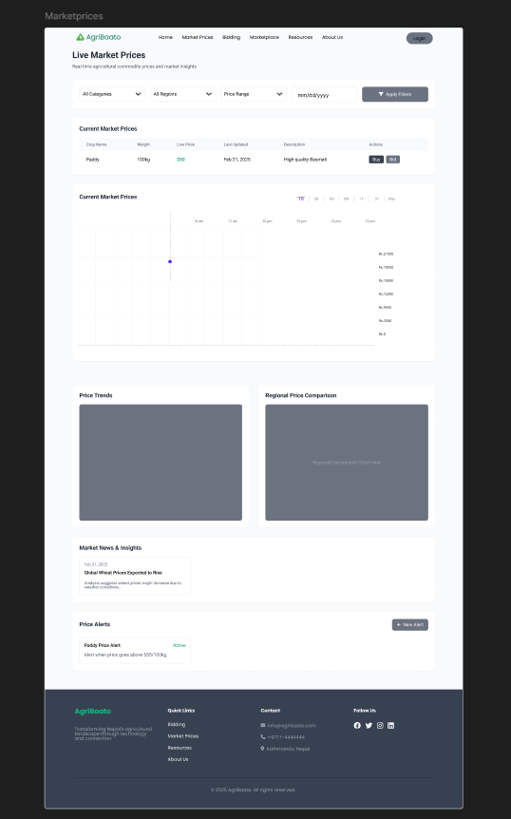
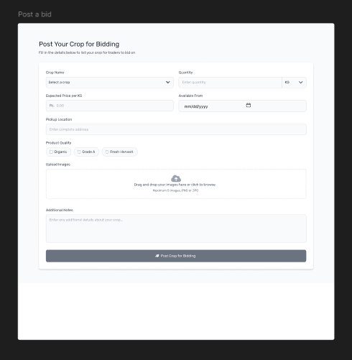
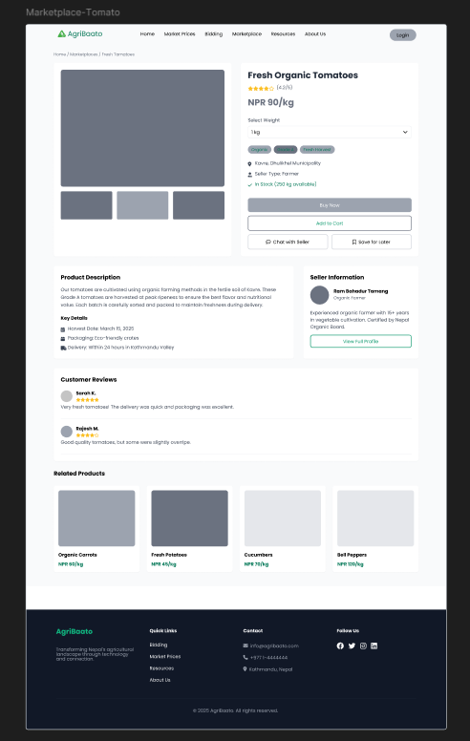
Low fidelity

Slide 16
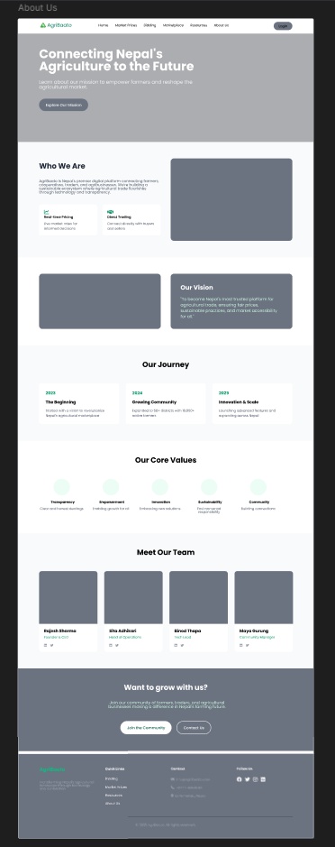
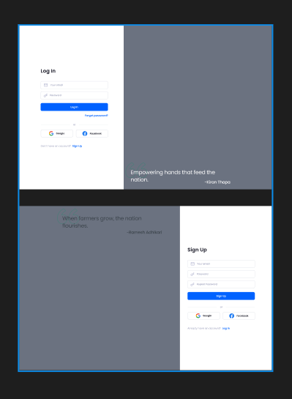
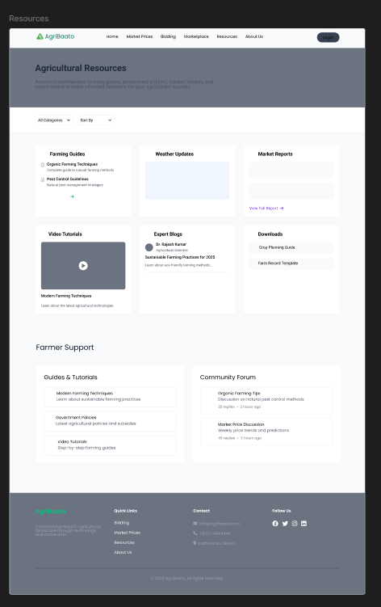
Low fidelity

Slide 17
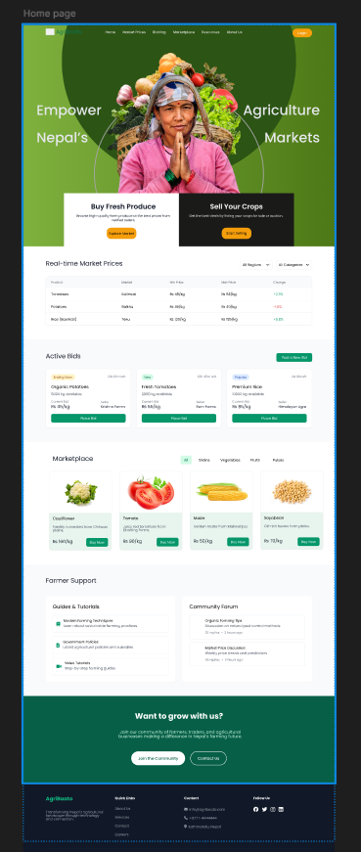
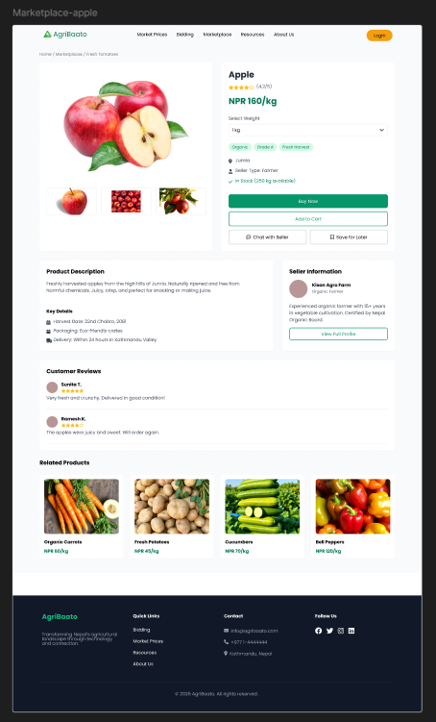
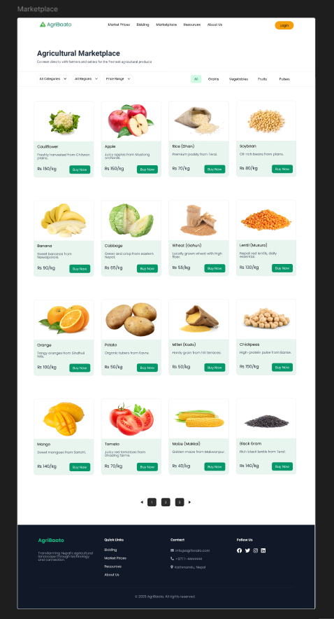
High fidelity

Slide 18
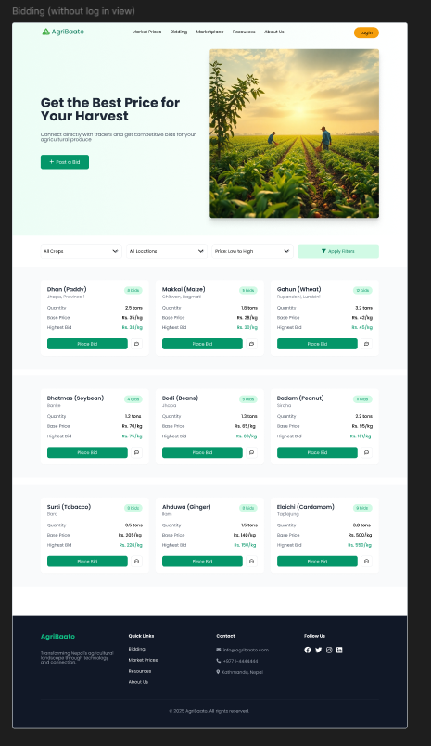
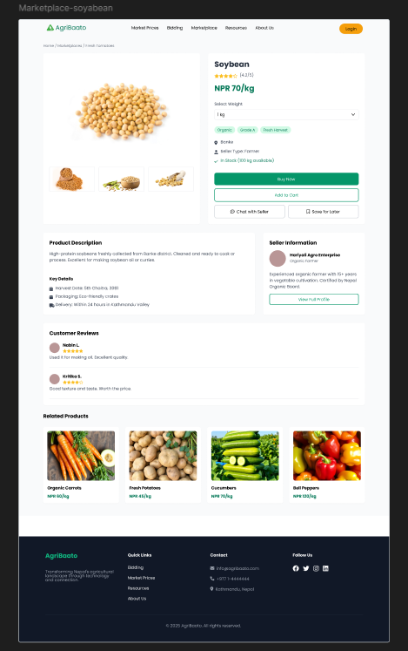
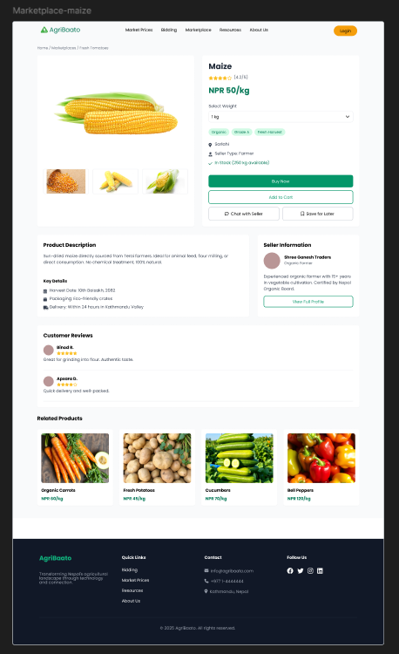
High fidelity

Slide 19
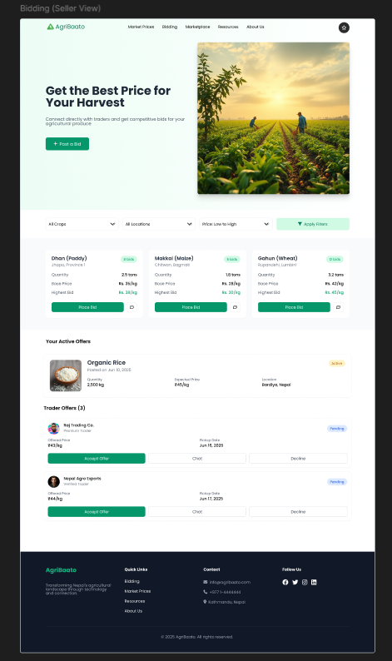
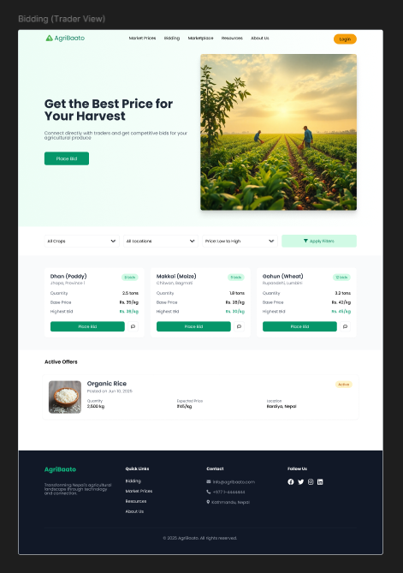
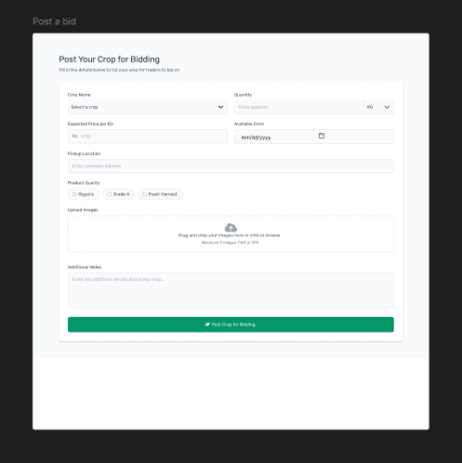
High fidelity

Slide 20
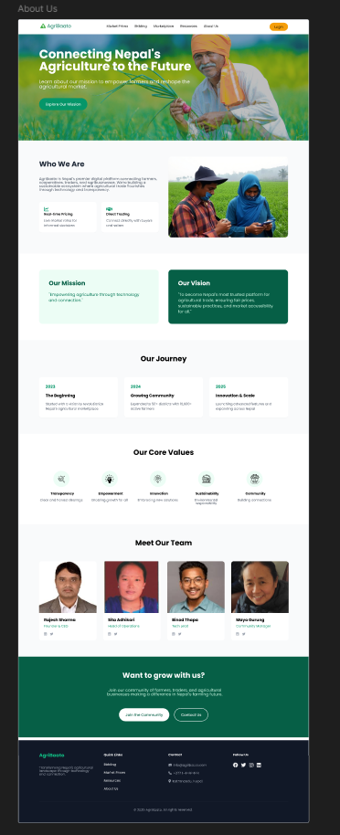
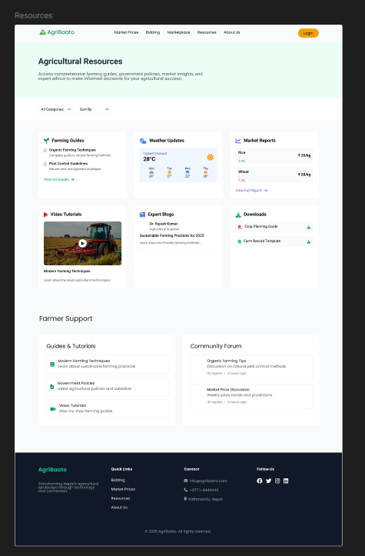
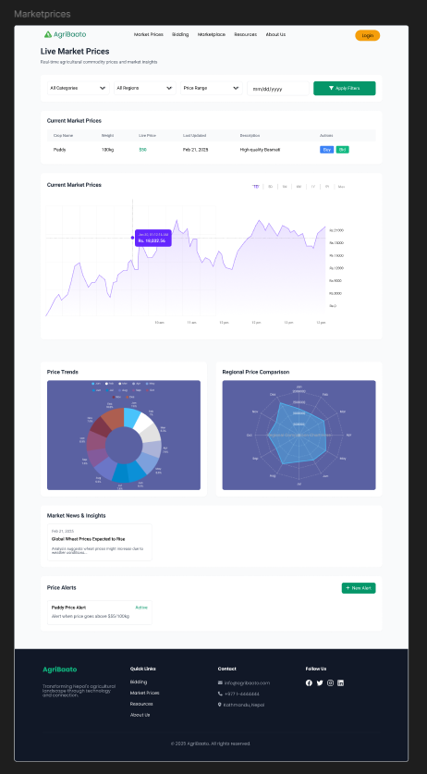
High fidelity

Slide 21
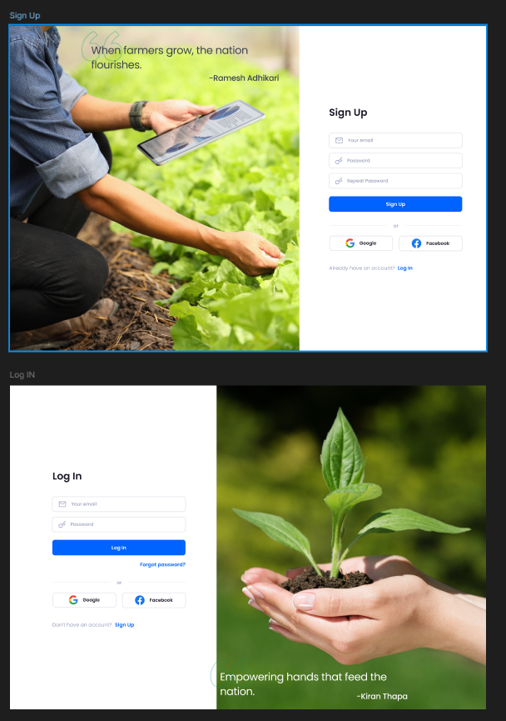
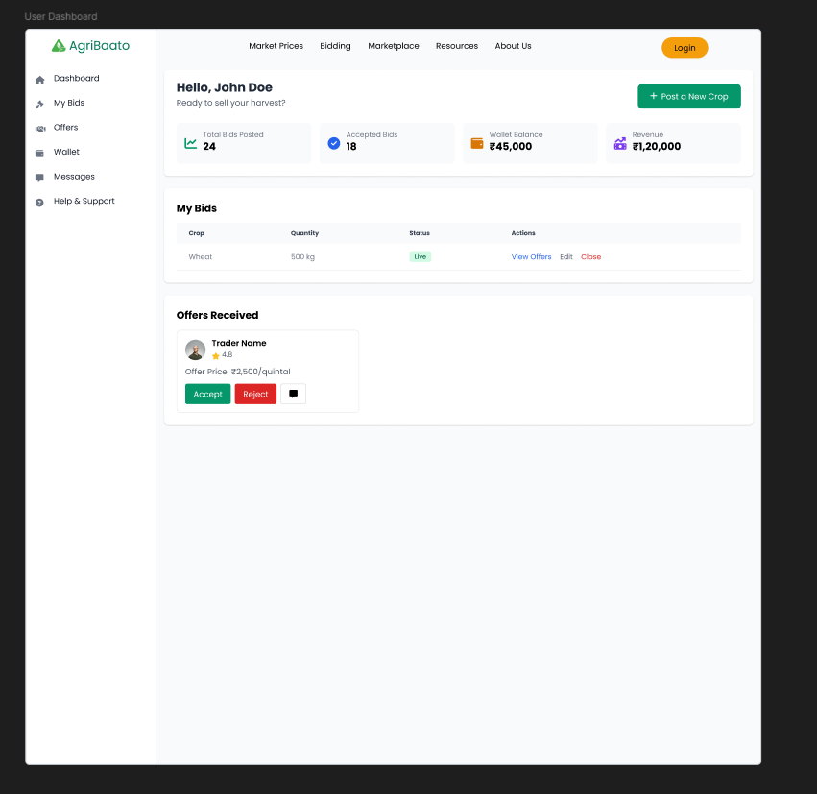
High fidelity

Slide 22
Survey Insights
Navigation: Most users found the layout easy to follow, but some suggested clearer labeling for menu items.
Visual Appeal: The majority appreciated the color scheme and clean design, describing it as modern and trustworthy.
Feature Usefulness: Users found real-time market prices and the bidding system to be the most valuable features.
Improvement Suggestions: Feedback included requests for language options, simpler instructions, and mobile-friendly optimization.

Slide 23

Thank you
Kritan Chandra Shrestha (M4)
London Met ID: 22067395
np01mm4a220078@islingtoncollege.edu.np

